Slide 1

agile Scrum

Slide 2
Objectives
What Agile Scrum is
What the product backlog
Definition of Ready (DoR)
What is the sprint backlog
Definition of Done (DoD)

Slide 3

The Scrum framework gets its name from Rugby In Rugby, the individual players work as a single unit to move.
Scrum is repetitive and will produce an addition of code at the end of every sprint.
The code will add functionality to what was there previously, therefore adding value.
This additional code should aim to be ‘shippable’; it shouldn't be half-broken, but ready to distribute.
AGILE SCRUM
http://www.scrumguides.org

Slide 4
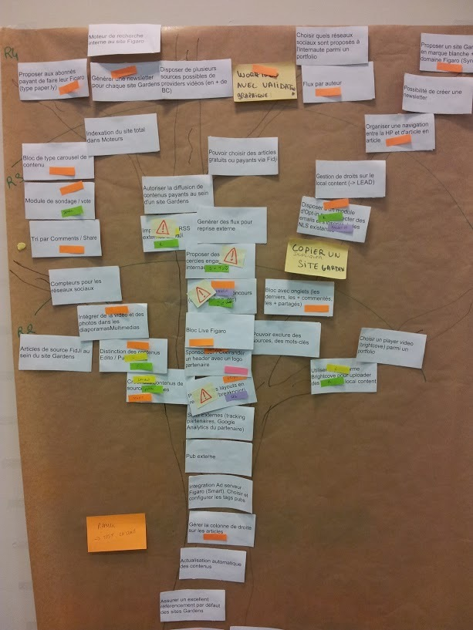
The Product Backlog is a list of all features, enhancements and fixes to be made to the product in future releases.
Items include a description, order, estimate, and value.
The product owner is responsible for the product backlog, including its content, availability, and ordering.
The development team will collaborate with the product owner, adding details to the backlog items where necessary
PRODUCT BACKLOG
This Photo by Unknown Author is licensed under CC BY-SA

Slide 5
Definition of Ready (DoR) defines what a product backlog item needs before it can go into the sprint backlog.
A checklist of items could include:
Definition of ready (DOR)
Technical details that have been discussed on the item and agreed
Assigning a priority
Acceptance Criteria

Slide 6
PBI Must have a clear description. A clear user story
Offer a clear Business value properly articulated and agreed
Acceptance criteria is clear and testable
Must have the staff to complete it
Its dependencies on other systems/things is identified. The team must make sure there are no dependencies blocking the PBI from being completed
And above all, the Product Owner has approved the user story
Product Backlog Item (PBI)

Slide 7
Definition of done (DoD) defines what is needed before it can be regarded as complete. Can be applied to a feature, a Sprint or a release.
A checklist of items which could be included for a feature could include:
Definition of done (DOD)
Unit testing written and passed
Documentation updated
Peer code review completed

Slide 8
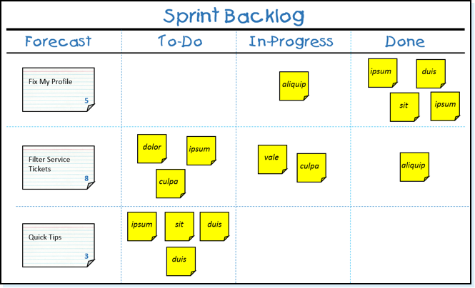
The sprint backlog is the set of product backlog items selected for inclusion in the sprint.
This items will meet the Definition of Done (DoD)
It shows all the work that the development team think necessary to meet the sprint goal.
As items are worked on, they move through the workflow
The workflow usually has at least 3 stages (To Do, In-progress and Done)
Sprint backlog
Notes:
Picture from https://www.scrum.org/forum/scrum-forum/60128/building-product-backlog-during-sprint-retrospective

Slide 9
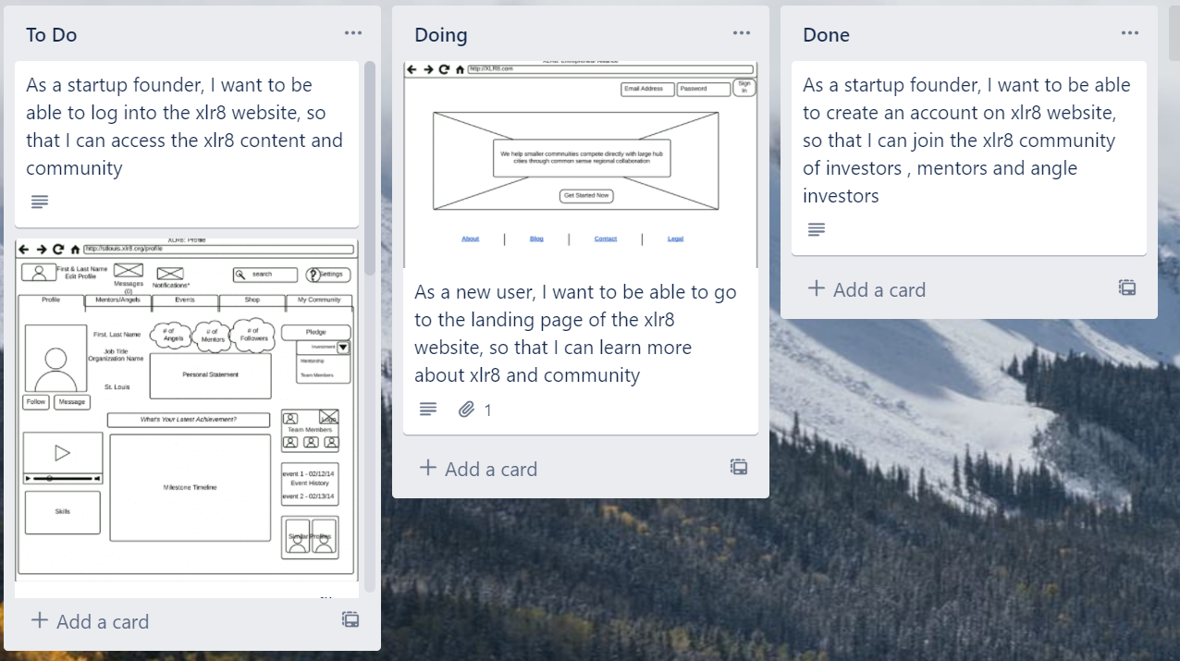
A sprint backlog is usually presented in a Kanban board.
As tasks are worked, the cards move from one end of the board to the other. This movement helps the team to see the project’s progress.
Trello is a common project tracking tool.
Sprint backlog

Slide 10
A sprint is a time-boxed event in which development work takes place.
The aim of a sprint is to produce new shippable code that can be used in production.
A sprint can be between 1 to 4 weeks long
Sprints will run one after another until the product no longer needs development.
What is a sprint?
Sprint 1
1
Sprint 2
2
Sprint 3

Slide 11

You now can
Review
describe what Agile Scrum is
Describe a product backlog
Explain (DoR)
Descibe the sprint backlog
Explain (DoD)

Slide 12
Complete Lab2
Duration 20 minutes
Lab

